Slide 1
Snow Leopard
Cuthbert
1.2
HPCX73599

Slide 2
——Table of Contents
·General Features
·Diet
·Females and Pups
·Threat to Survival
·Conservation Mearsures
·What can WE Do?
·References

Slide 3
——General Features
·Pathera uncia
·Estimated 4000-6500
·Vulnerable
·High mountains
2 million km²≈800000 square miles
·2-5 ft
1 per 40 square miles
·60-120 lbs (30-60 kg)
20000 snow leopards
·Shy and reclusive

Slide 4
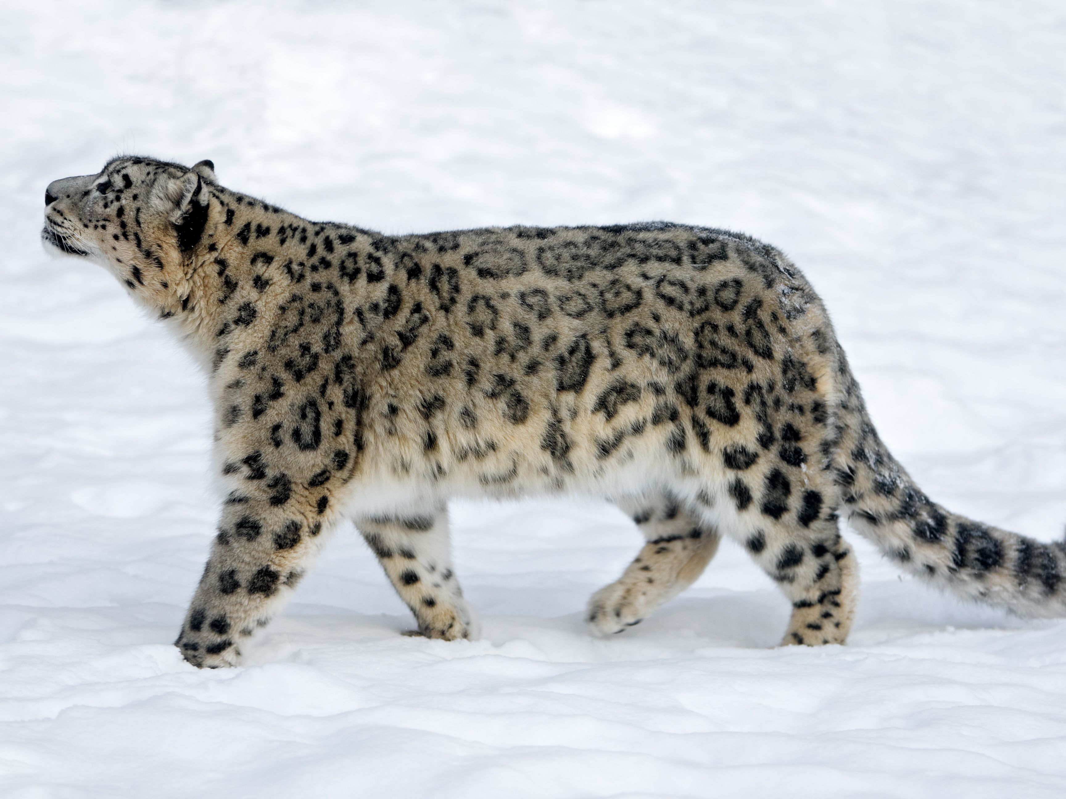
Very strong jaws, able to tear through skin and flesh of prey easily
Long tail enable balance and agility, provides warmth
Black and yellow camouflage helps it blend into the environment
Strong hind leg let’s it leap 5 times the length of it’s body

Slide 5
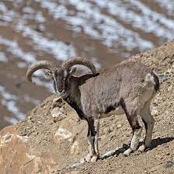
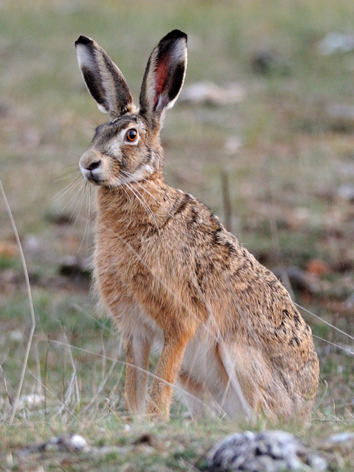
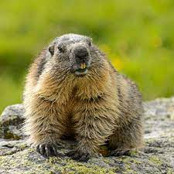
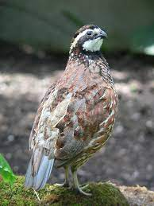
——Diet
·Blue sheep
·Hare
·Marmot
·Bird
Can kill animals 3 times their wight

Slide 6
——Females and Pups
·2 or 3 years
·1-5 pups each litter
·2-3 pups
At birth
7 days
2 months
3 months
Small and helpless
Open their eyes
Eat solid
Follow mom around
19-24 months
Reach Independence

Slide 7
——Threat to Survival
·Human
·Poaching
·Retaliatory killing
·Habitat loss

Slide 8
——Conservation Measures
·Better pens for livestock
·Reduce retaliatory killing
·Better surveillance network
·Spot poachers
·Raise public awareness
·Build protection zones

Slide 9
——What can WE Do
·Share what we know
·Public awareness
·Adopt a snow leopard

Slide 10
Thank You!

Slide 11
——References
11 Ways to Help Snow Leopards, https://www.takeactionforwildlifeconservation.com/11-ways-to-help-snow-leopards.html.
Molotnikova, Mariya. “Save – Sustainable Wildlife and Environmental Conservation.” SAVE Wildlife, 15 Feb. 2022, https://save-wildlife.org/en/?gclid=CjwKCAjwtIaVBhBkEiwAsr7- cwq_KfKCaEKm3BCKcrPVXcnoCRv2r8LFYE39gz1CKmTuRj2dSRbZ9RoCO30QAvD_BwE.
“Care for Us.” Wild Welfare, https://wildwelfare.org/care-for-us/?gclid=CjwKCAjwtIaVBhBkEiwAsr7-cz9CwGhVbr7O-SFTZlCCwBMgsZwz6bMl2BduJF_h2eFQuKHBoRcG6RoCQc4QAvD_BwE.
“Snow Leopard.” WWF, World Wildlife Fund, https://www.worldwildlife.org/species/snow-leopard. Accessed 27 May, 2022.
“Snow Leopard, Facts and Photos.” Animals, https://www.nationalgeographic.com/animals/mammals/facts/snow-leopard. Accessed 27 May, 2022.
Snow Leopard Trust. “7 Essential Facts about Snow Leopard Cubs.” Snow Leopard Trust, 13 Oct. 2016, https://snowleopard.org/7-essential-facts-about-snow-leopard-cubs/. Accessed 27 May, 2022.

